Slide 1

AI 芯片
— AI 计算体系
深度学习计算模式
ZOMI

Slide 2
Talk Overview
AI 计算体系
深度学习计算模式
计算体系与矩阵运算
AI 芯片基础
通用处理器 CPU
从数据看 CPU 计算
通用图形处理器 GPU
AI专用处理器 NPU/TPU
计算体系架构的黄金10年

Slide 3
Talk Overview
深度学习计算模式
The History – CPU 发展历史和组成
Parallel Architecture – CPU 并行处理架构
RoadMap of AI Chip – ISA指令集架构
Application – CPU的应用场景

Slide 4
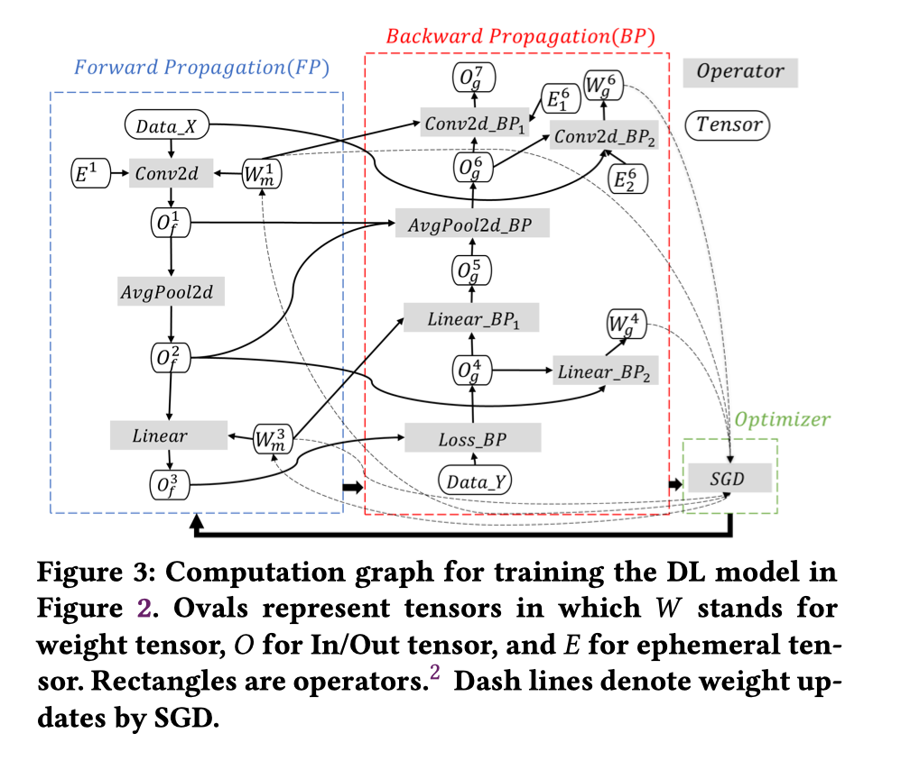
什么决定比特带宽 What Determines Bit Width ?
在AI流程里，不同数据会使用不同类型格式，才能保证精度达标。
训练 Training: weights, activation, partial sums, gradients and weight update.
推理 Inference: weights, activations, partial sums
（所需的精度可能因数据类型而异 Required precision can vary across data types. ）

Slide 5
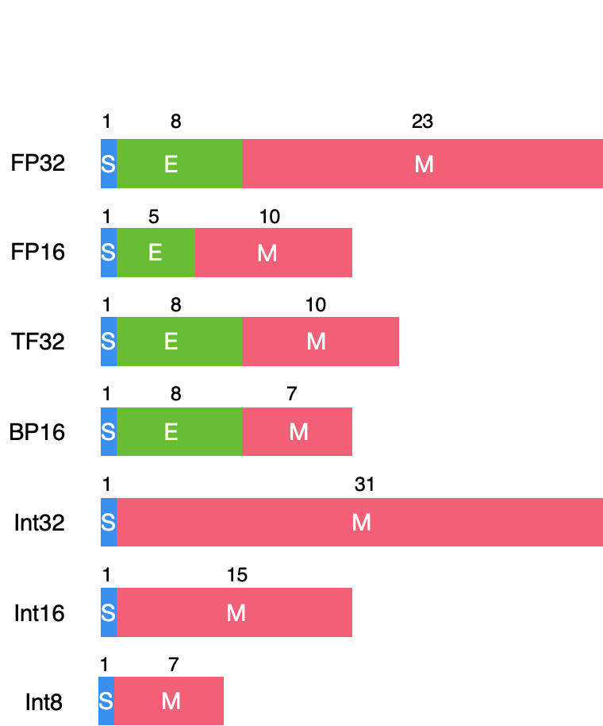
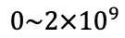
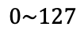
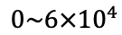
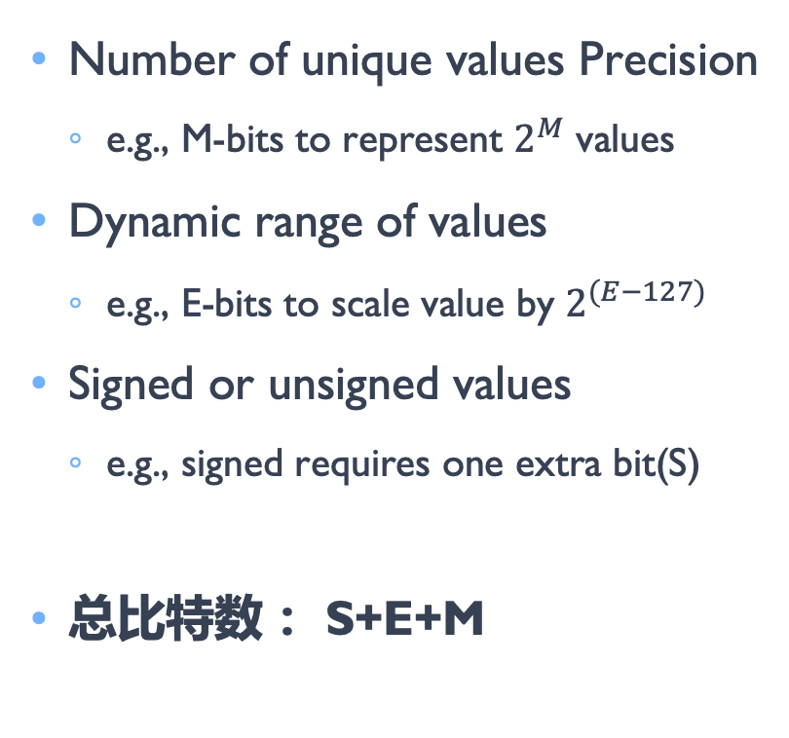
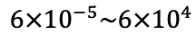
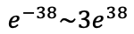
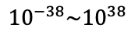
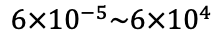
什么决定比特带宽 What Determines Bit Width ?
Range
Number of unique values Precision
e.g., M-bits to represent $2^{M}$ values
Dynamic range of values
e.g., E-bits to scale value by $2^{(E−127)}$
Signed or unsigned values
e.g., signed requires one extra bit(S)
总比特数： S+E+M
$${10}^{−38}\sim {10}^{38}$$
$$6×{10}^{−5}\sim {6×10}^{4}$$
$$6×{10}^{−5}\sim {6×10}^{4}$$
$$e^{−38}\sim {3e}^{38}$$
$$0\sim {2×10}^{9}$$
$$0\sim {6×10}^{4}$$
$$0\sim 127$$

Slide 6
什么决定比特带宽 What Determines Bit Width ?
Range
Floating Point(FP) allows range to change for each value(E-bits)
Fixed Point(Int) has fixed range
Default CPU/GPU is 32-bit float(FP32)
$${10}^{−38}\sim {10}^{38}$$
$$6×{10}^{−5}\sim {6×10}^{4}$$
$$6×{10}^{−5}\sim {6×10}^{4}$$
$$e^{−38}\sim {3e}^{38}$$
$$0\sim {2×10}^{9}$$
$$0\sim {6×10}^{4}$$
$$0\sim 127$$

Slide 7
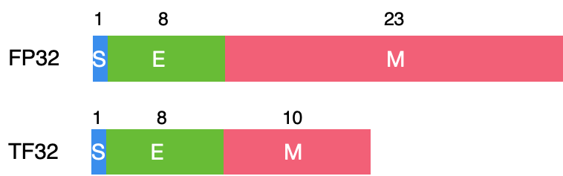
Efficient Processing of Deep Neural Network
Reduce number of unique values – Precision(M-bits)
Default: Uniform quantization (values are equally spaced out)
None-uniform quantization (spacing can be computed)
Fewer unique values can make transforms and compression more effective
Reduce dynamic range(E-bits)
If Possible, fix range (used fixed point)
Share range across group of values (weights for a layer or channel)
Tradeoff between number of bits allocated to M-bits and E-bits
S=1, E=5, M=10, Total bits=32
S=1, E=8, M=7, Total bits=19

Slide 8


Slide 9
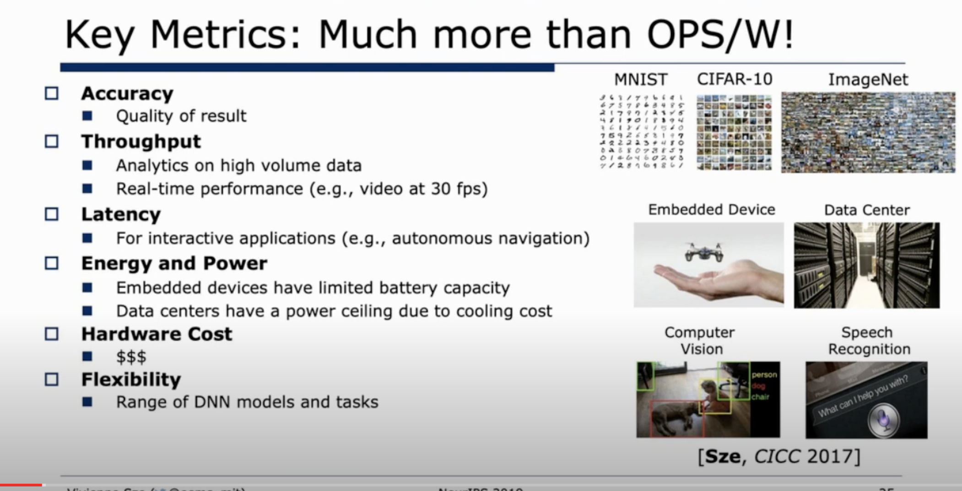

Slide 10
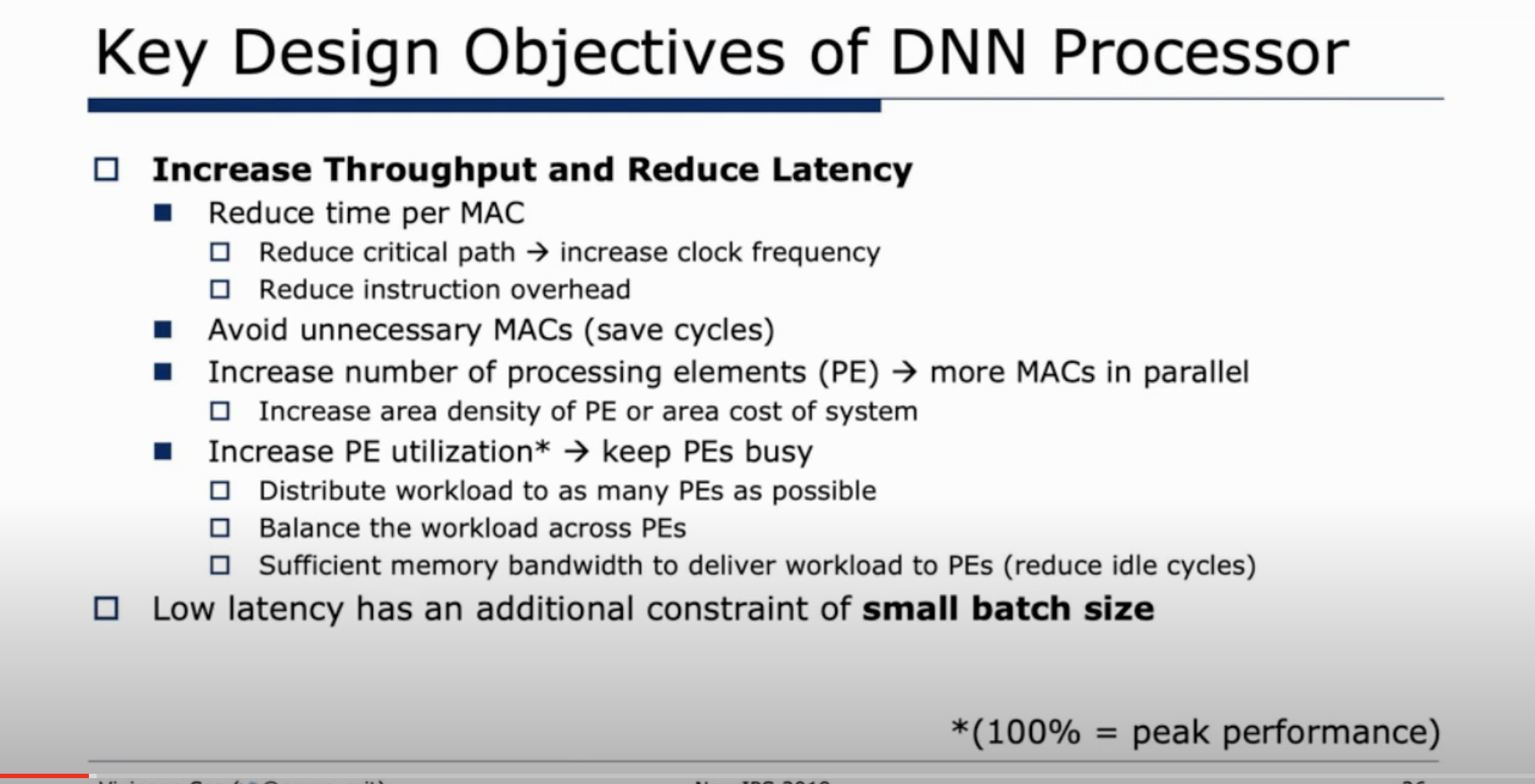

Slide 11
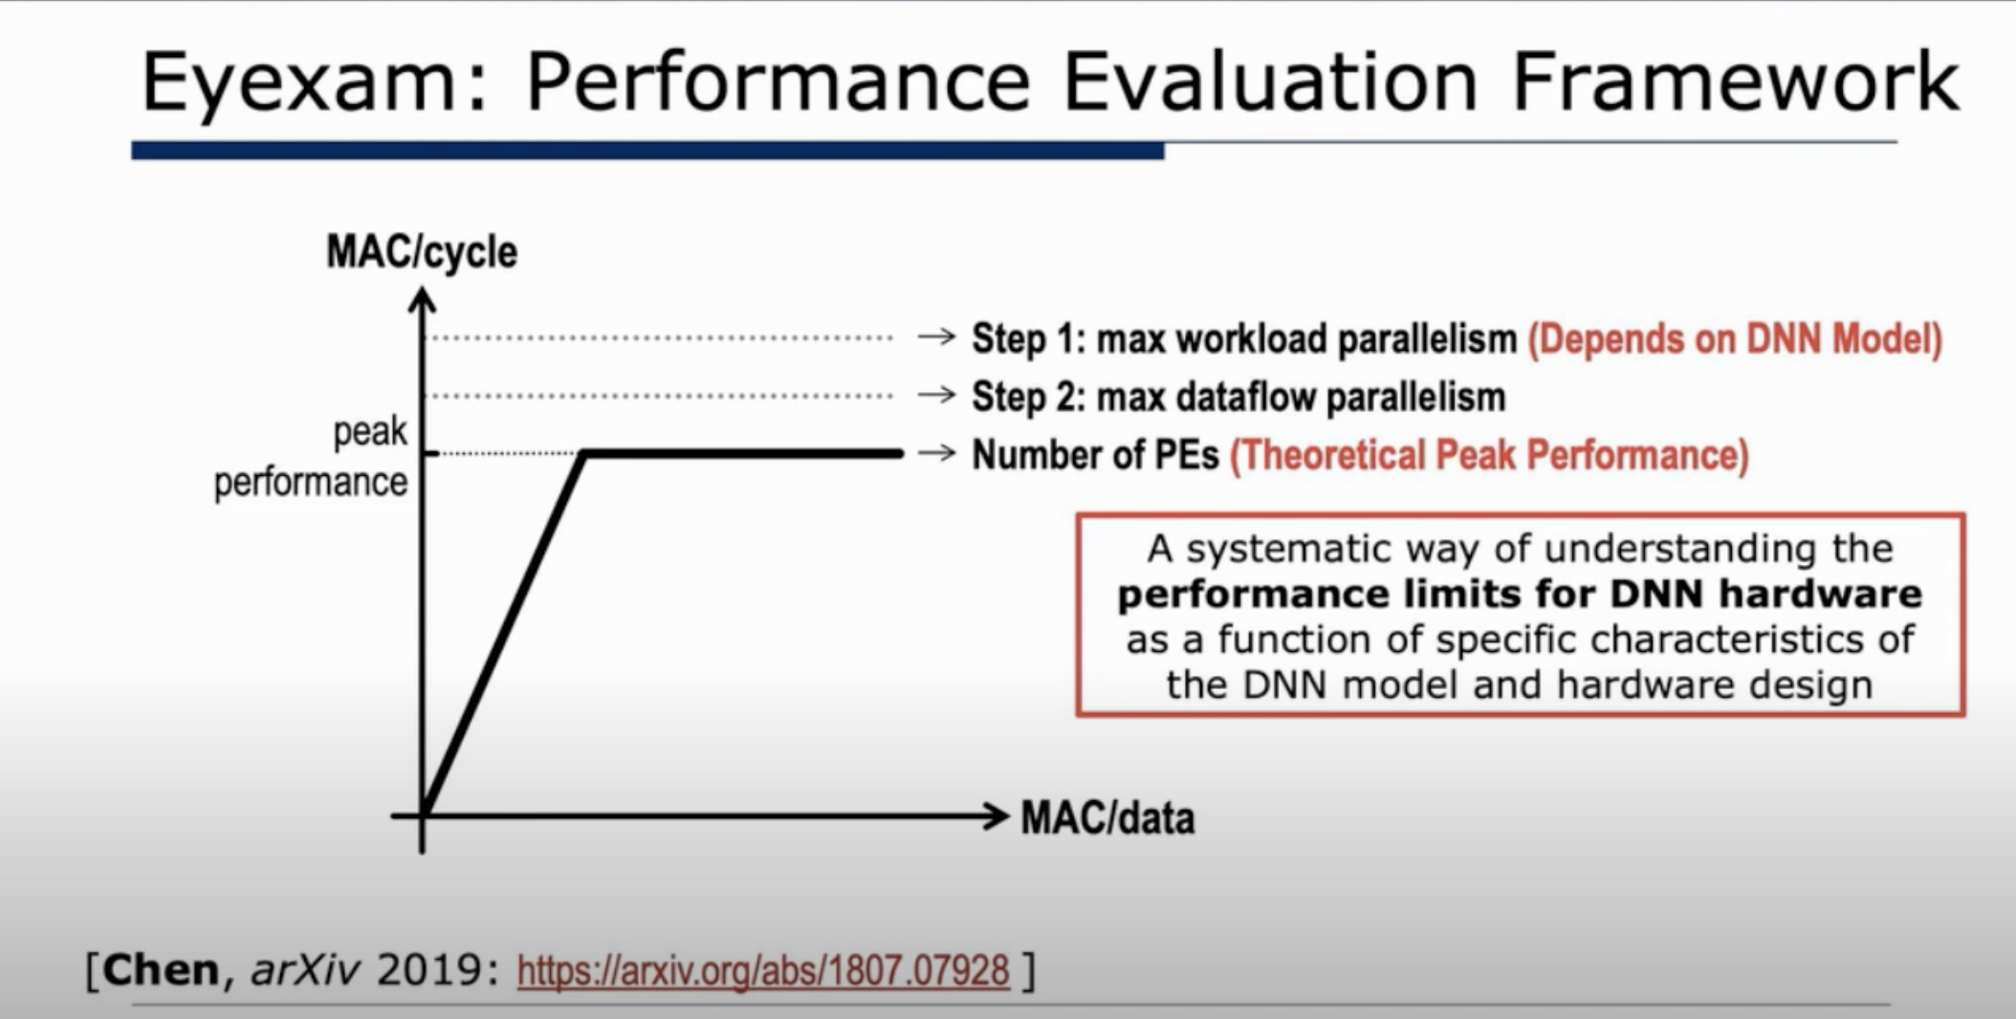

Slide 12
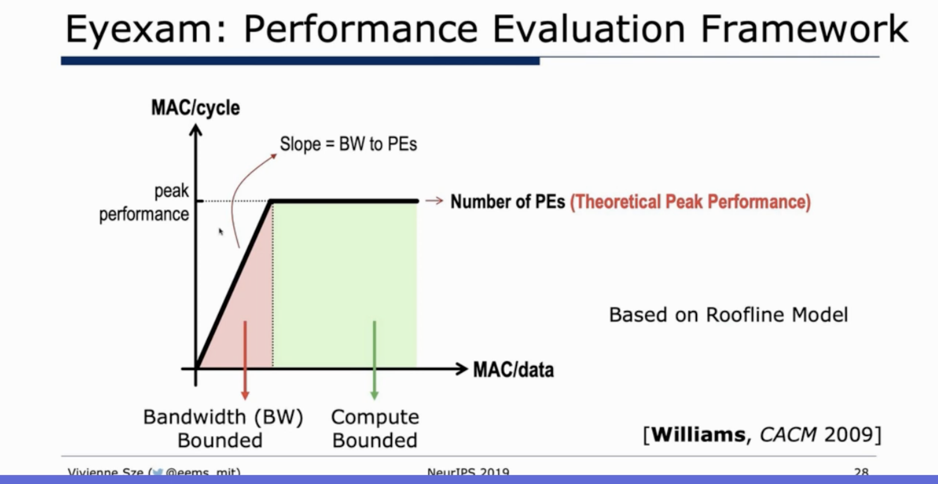

Slide 13
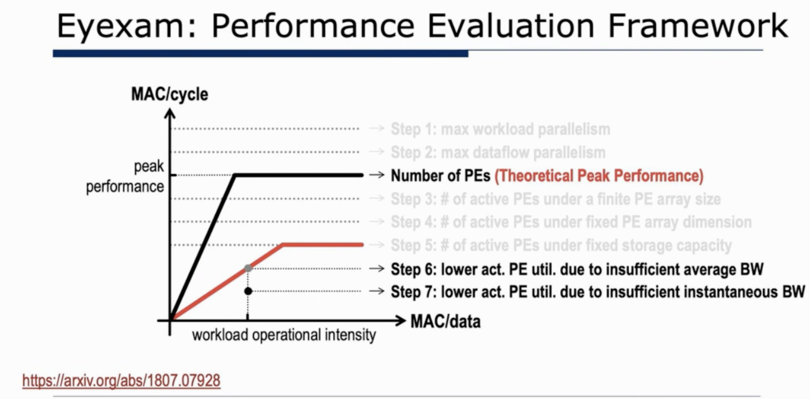

Slide 14
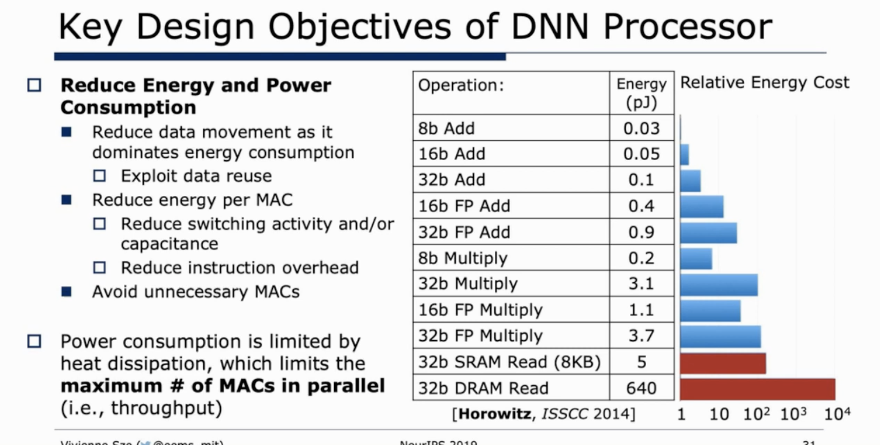

Slide 15
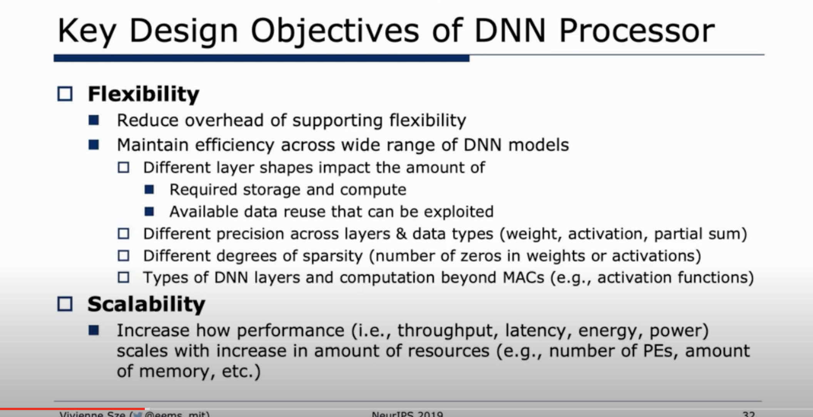

Slide 16
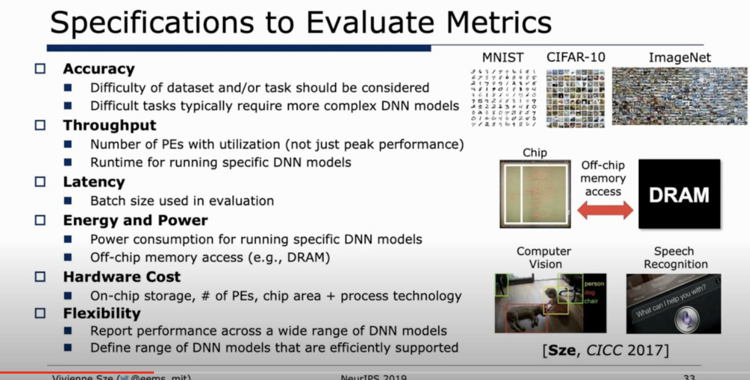

Slide 17
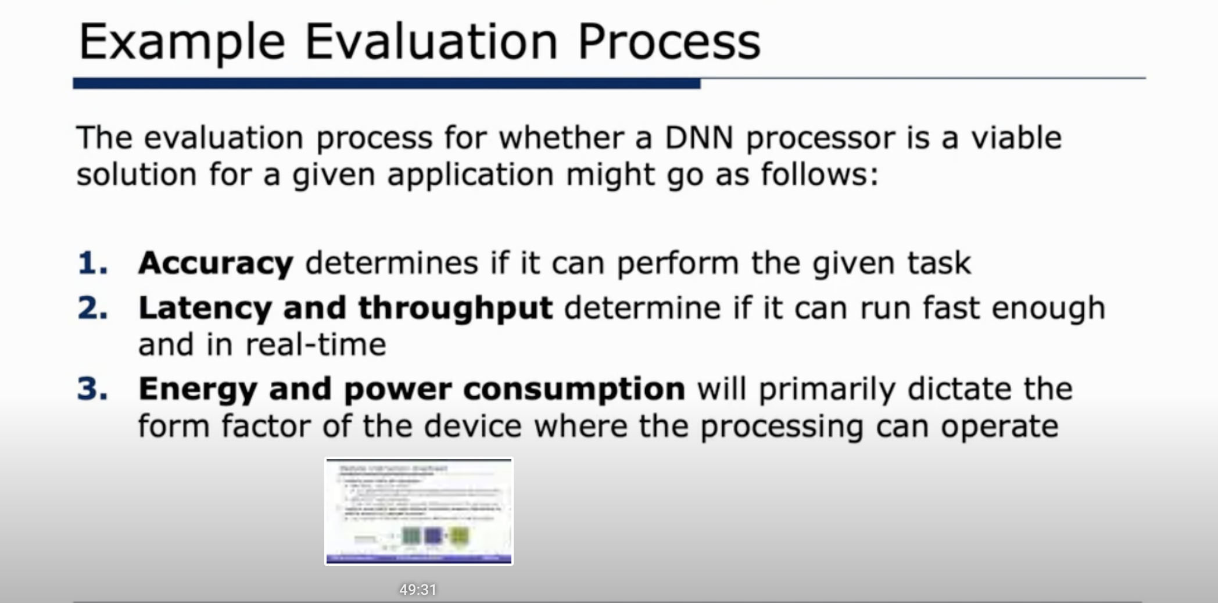

Slide 18
矩阵运算

Slide 19
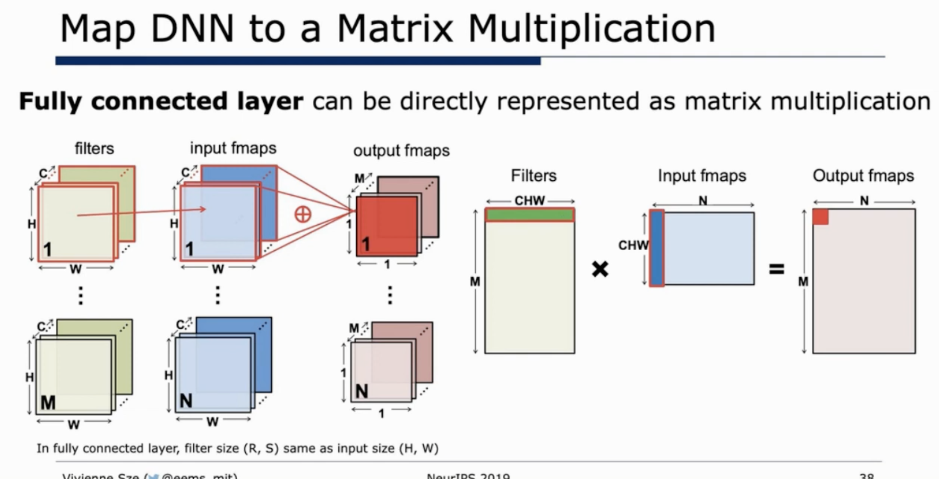

Slide 20
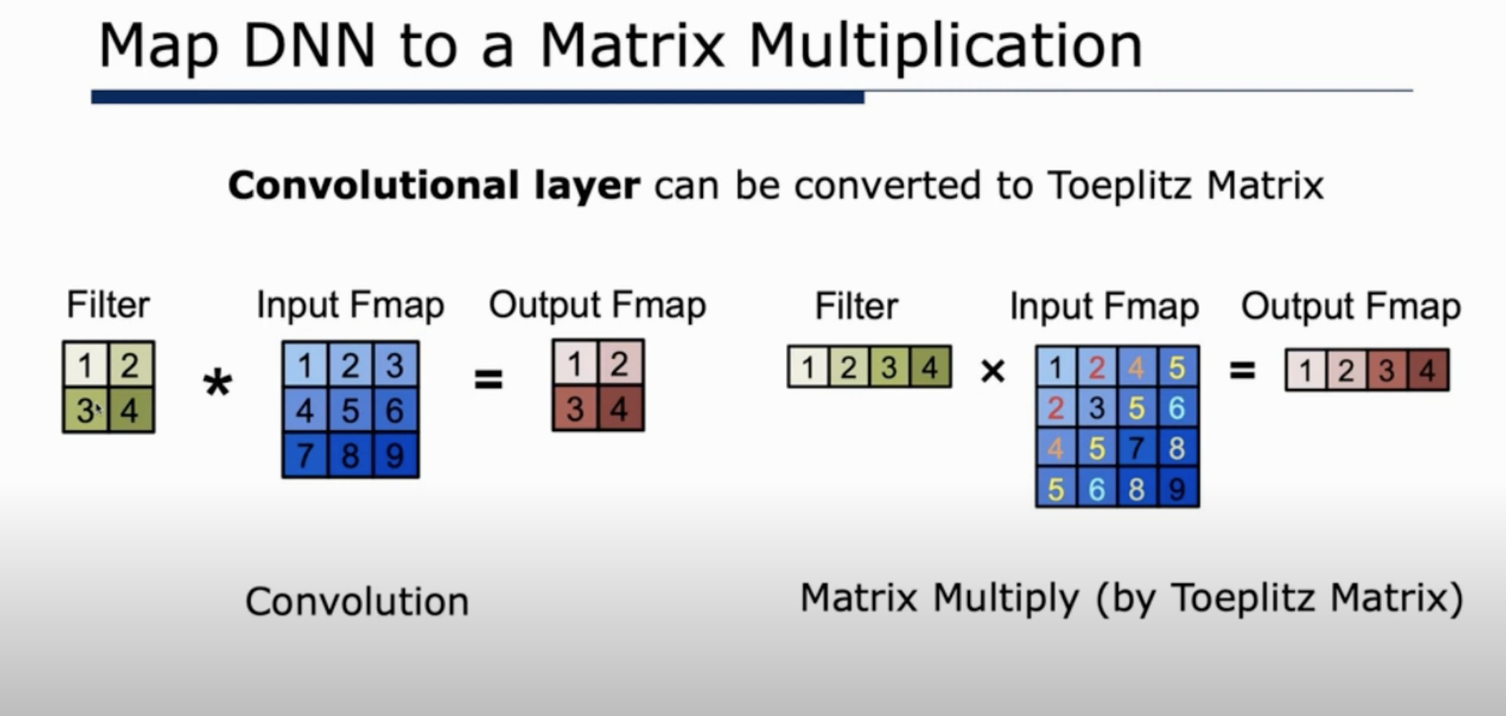

Slide 21
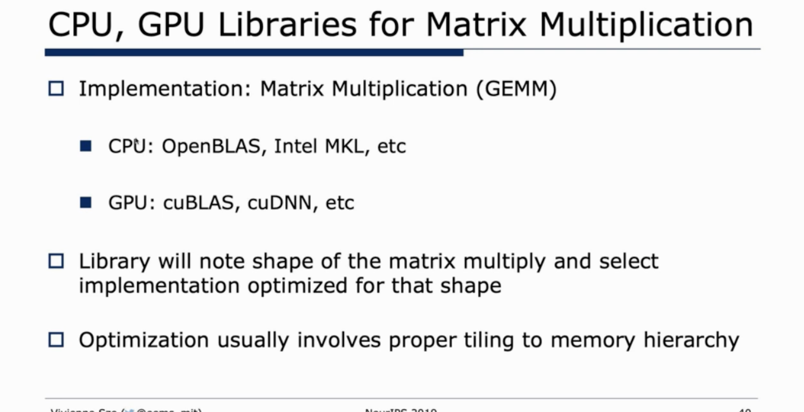

Slide 22
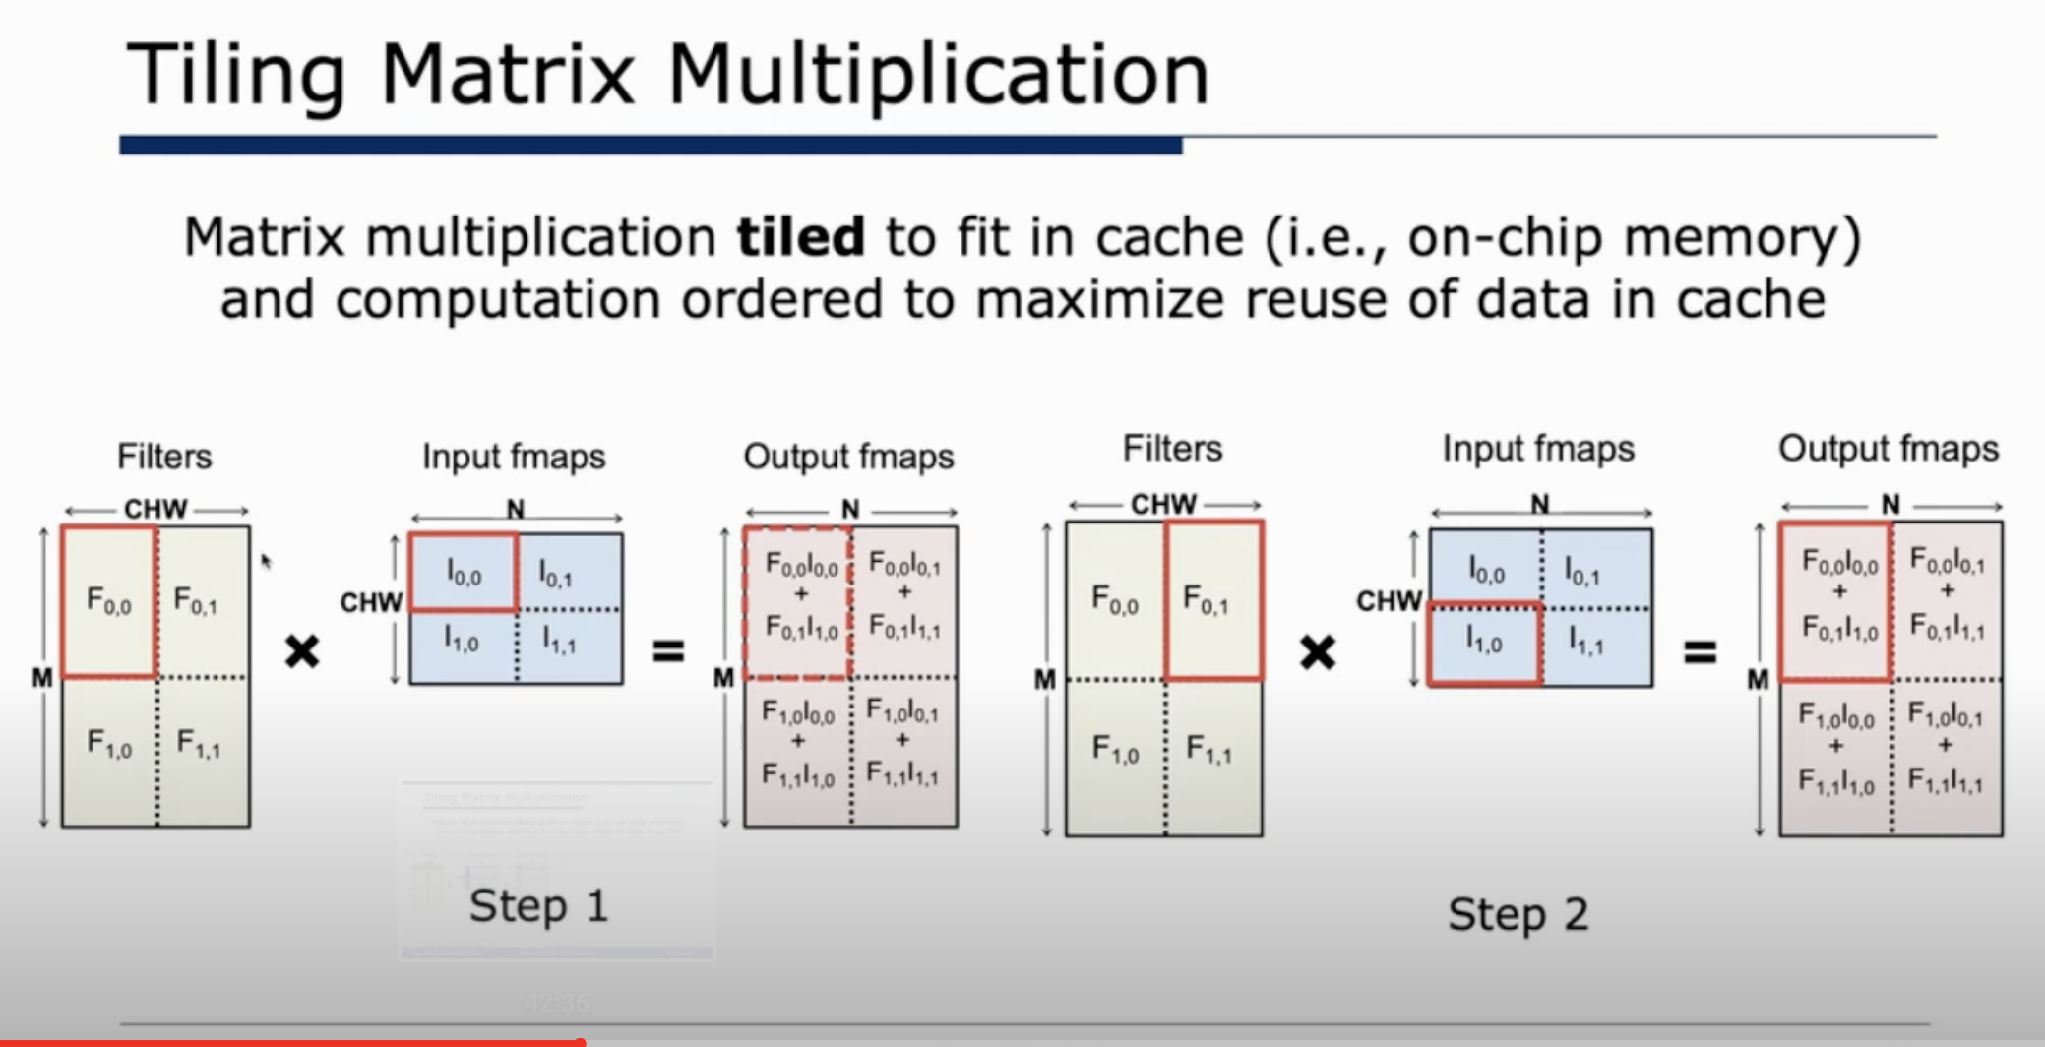

Slide 23
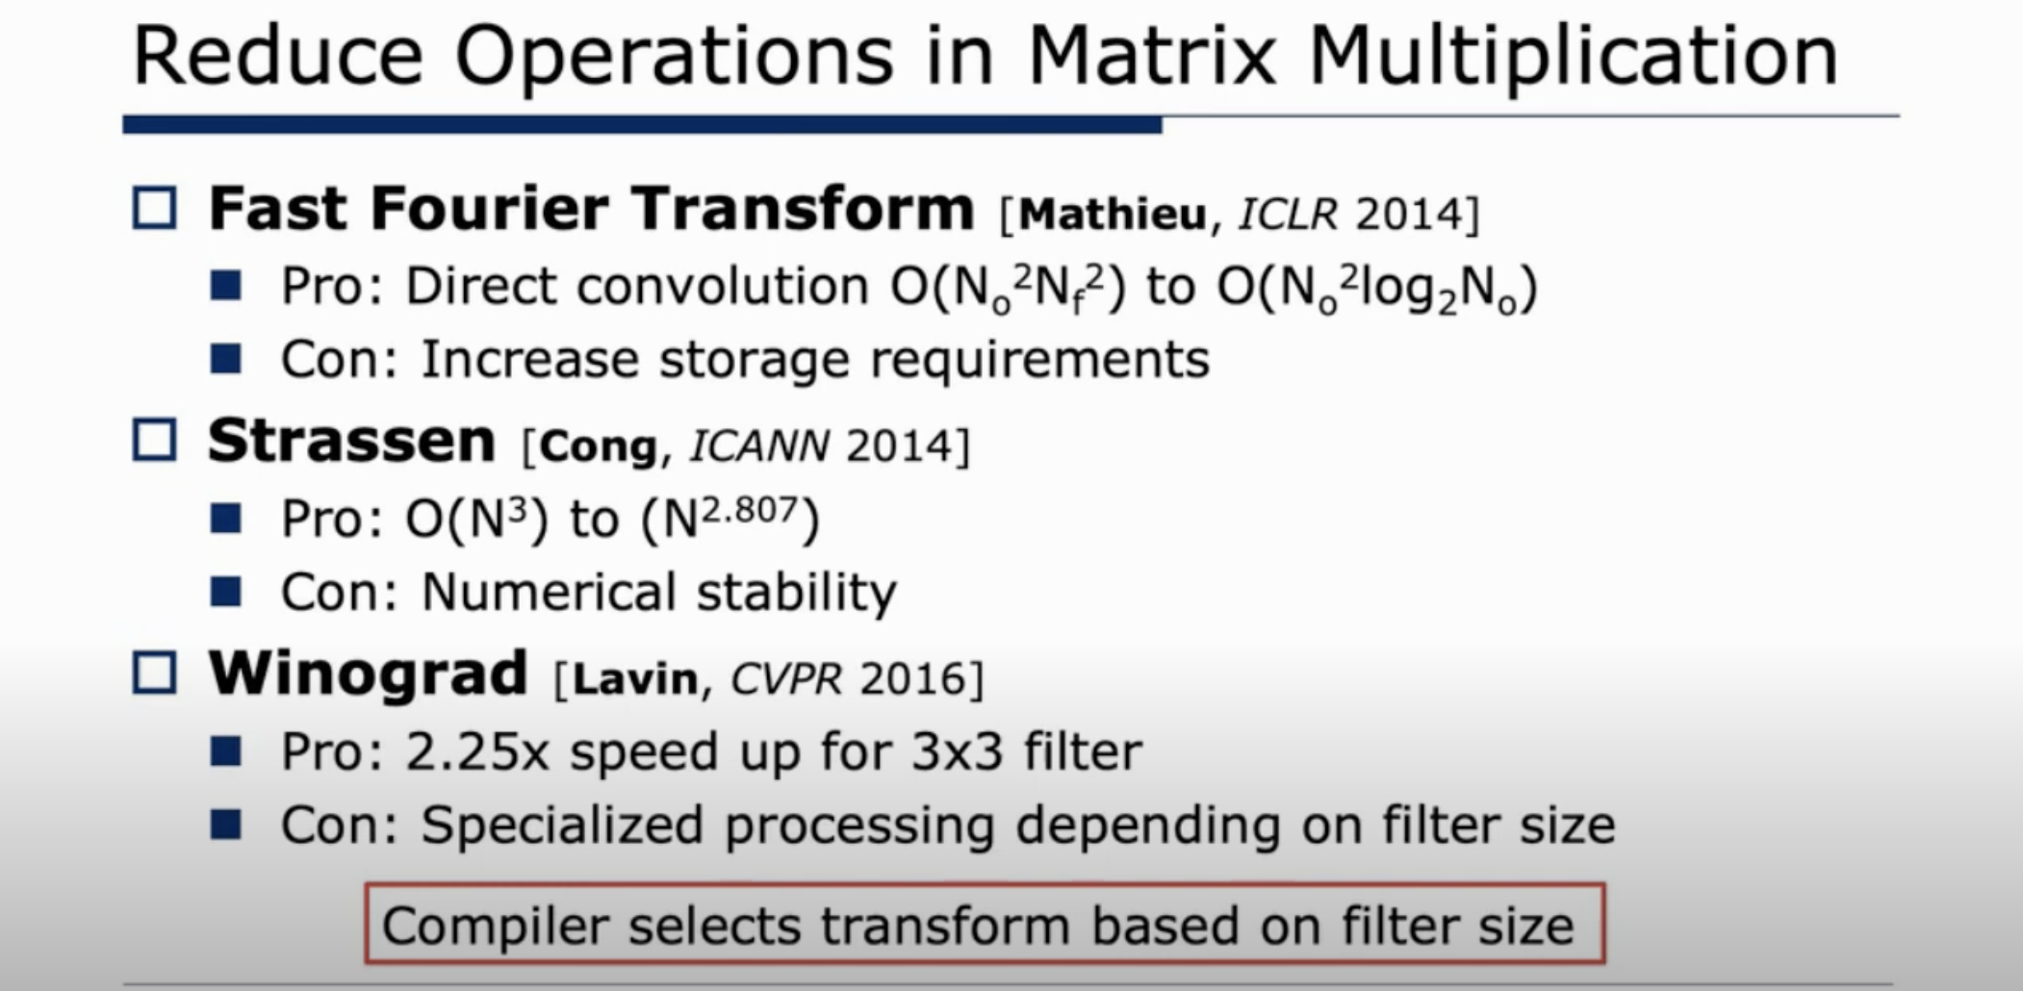

Slide 24
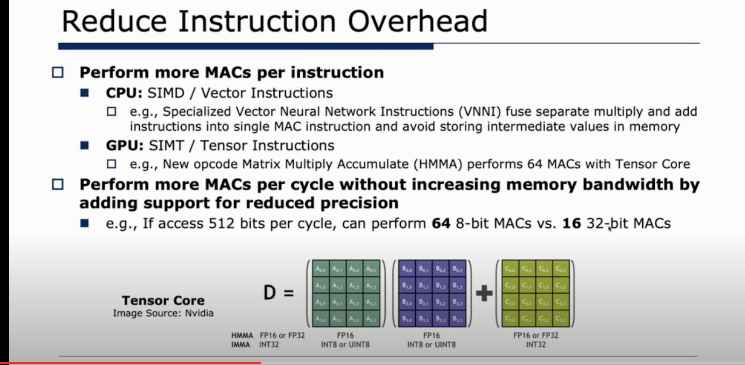

Slide 25
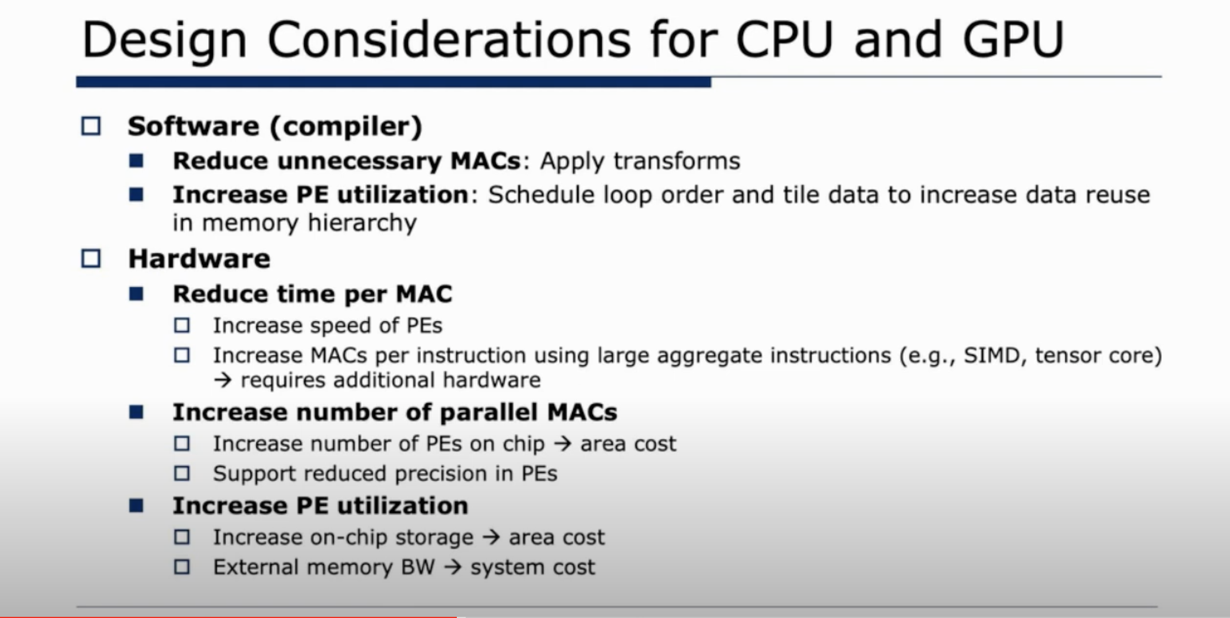

Slide 26
硬件优化方案

Slide 27


Slide 28
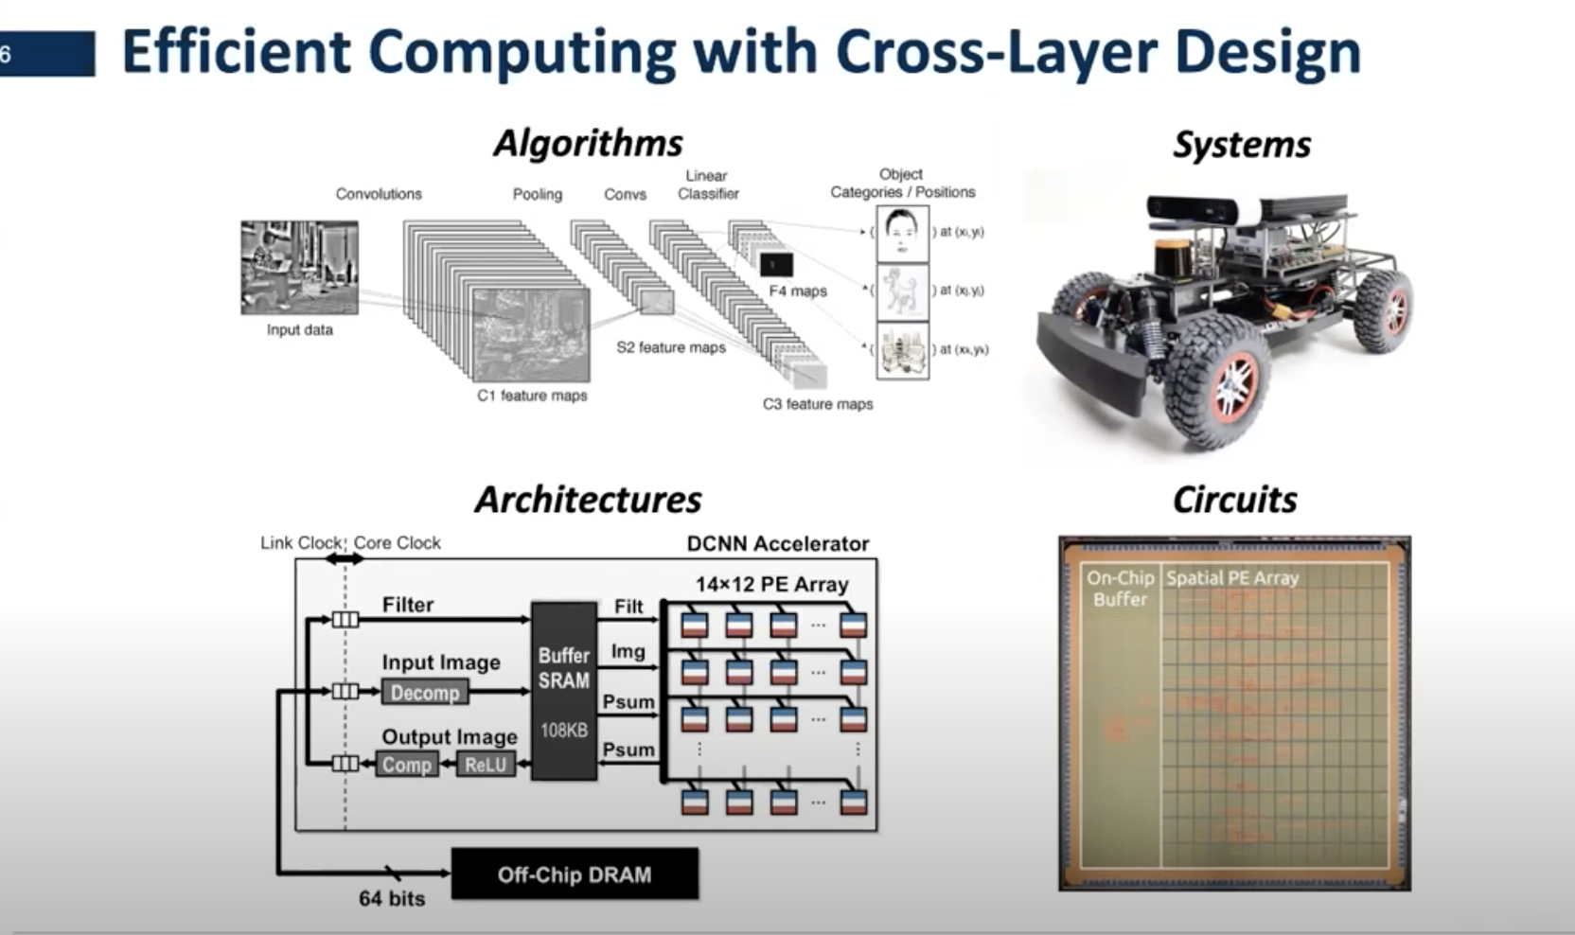
CPU 发展历史和组成

Slide 29
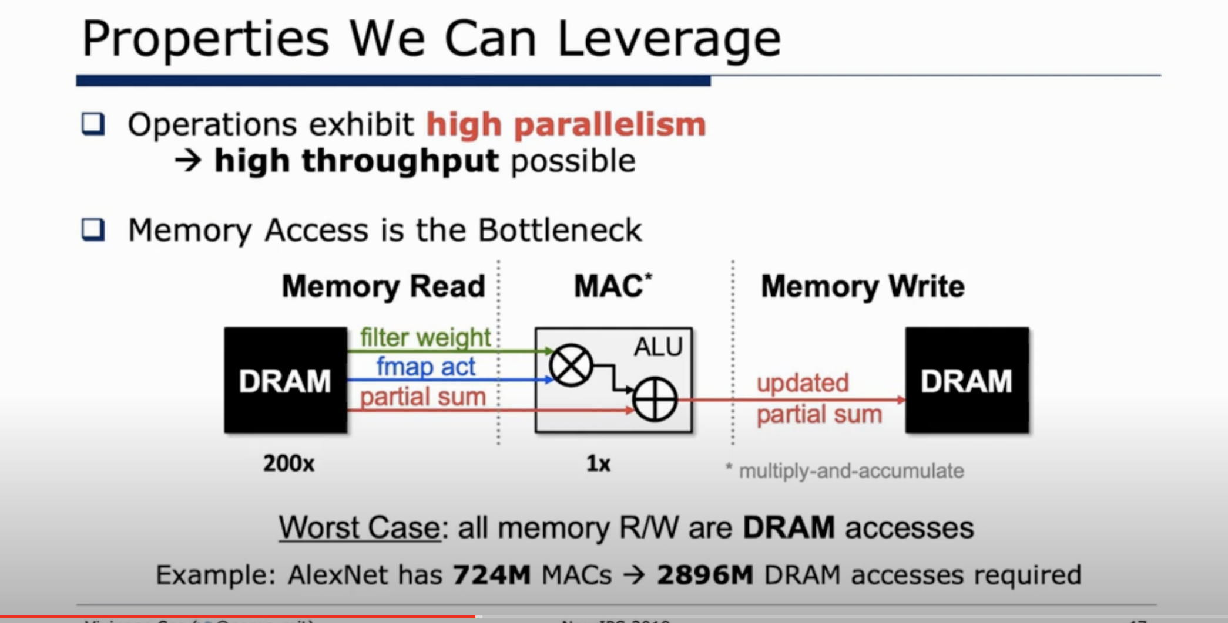

Slide 30
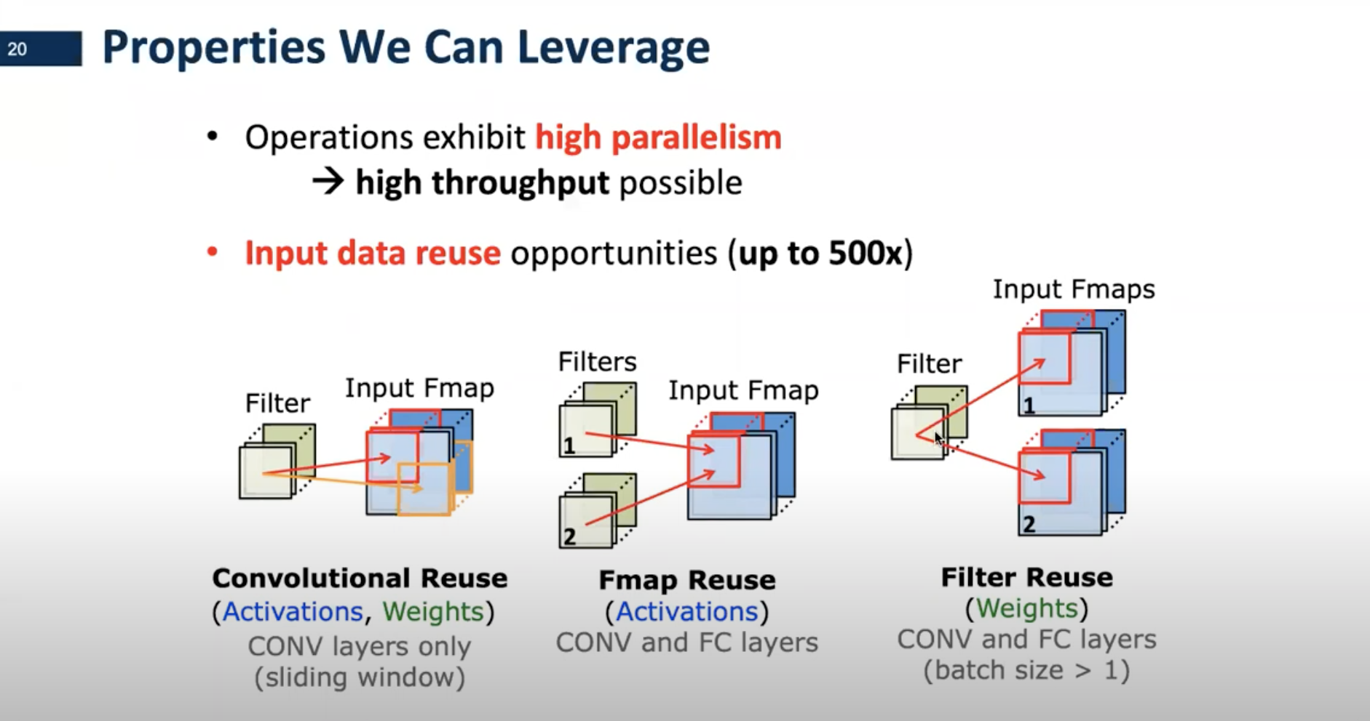
通过对cnn进行分析，看怎么重用相关数据，减少数据的搬运和读取，从而节省energy

Slide 31
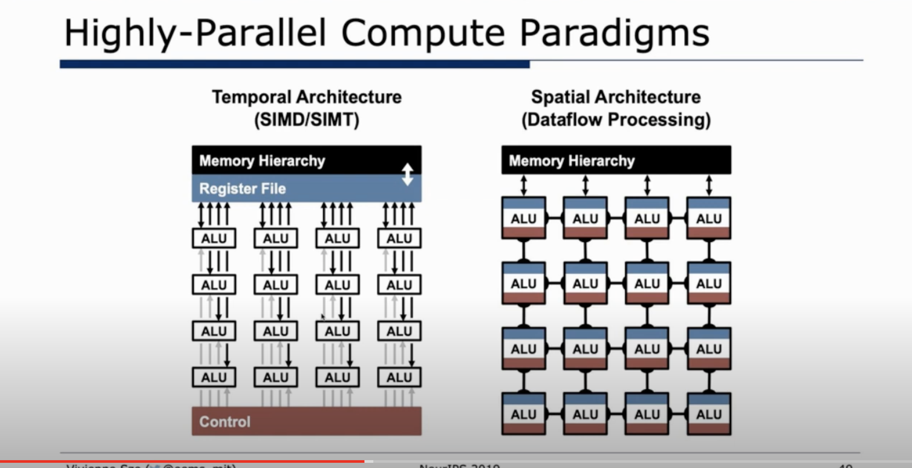

Slide 32
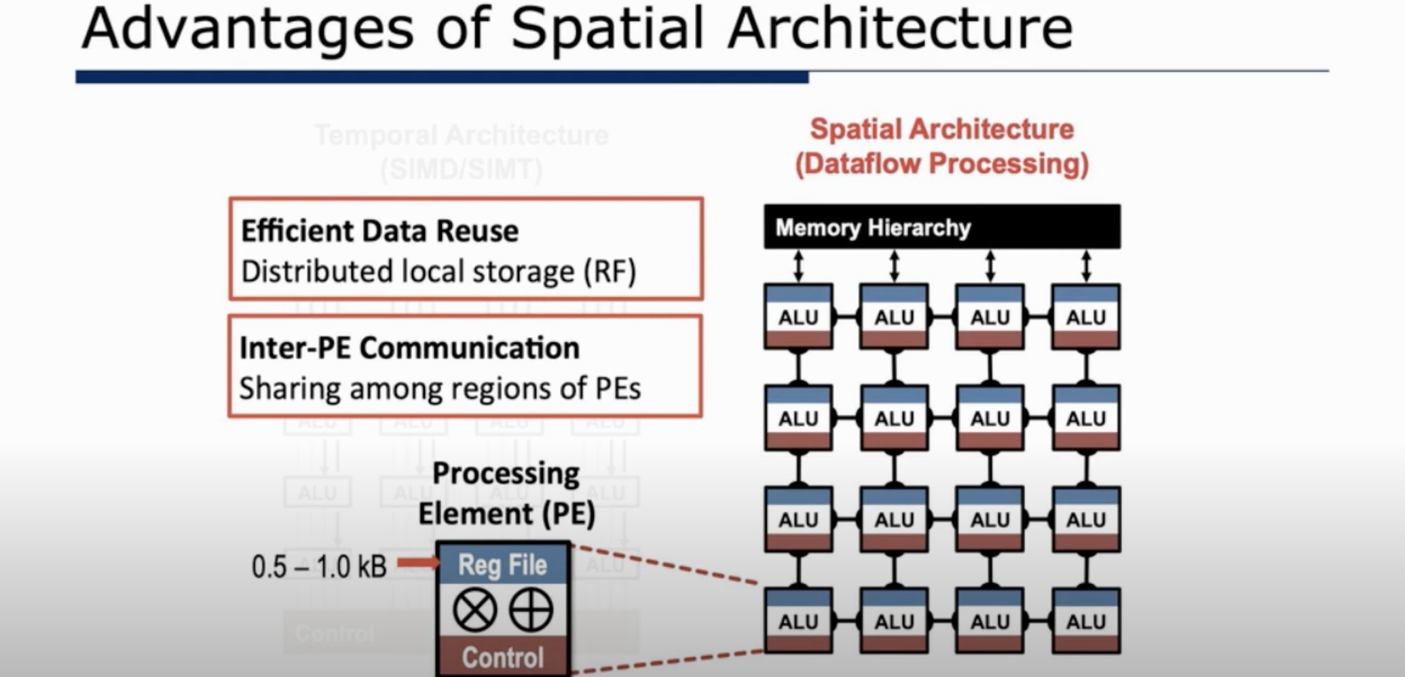

Slide 33
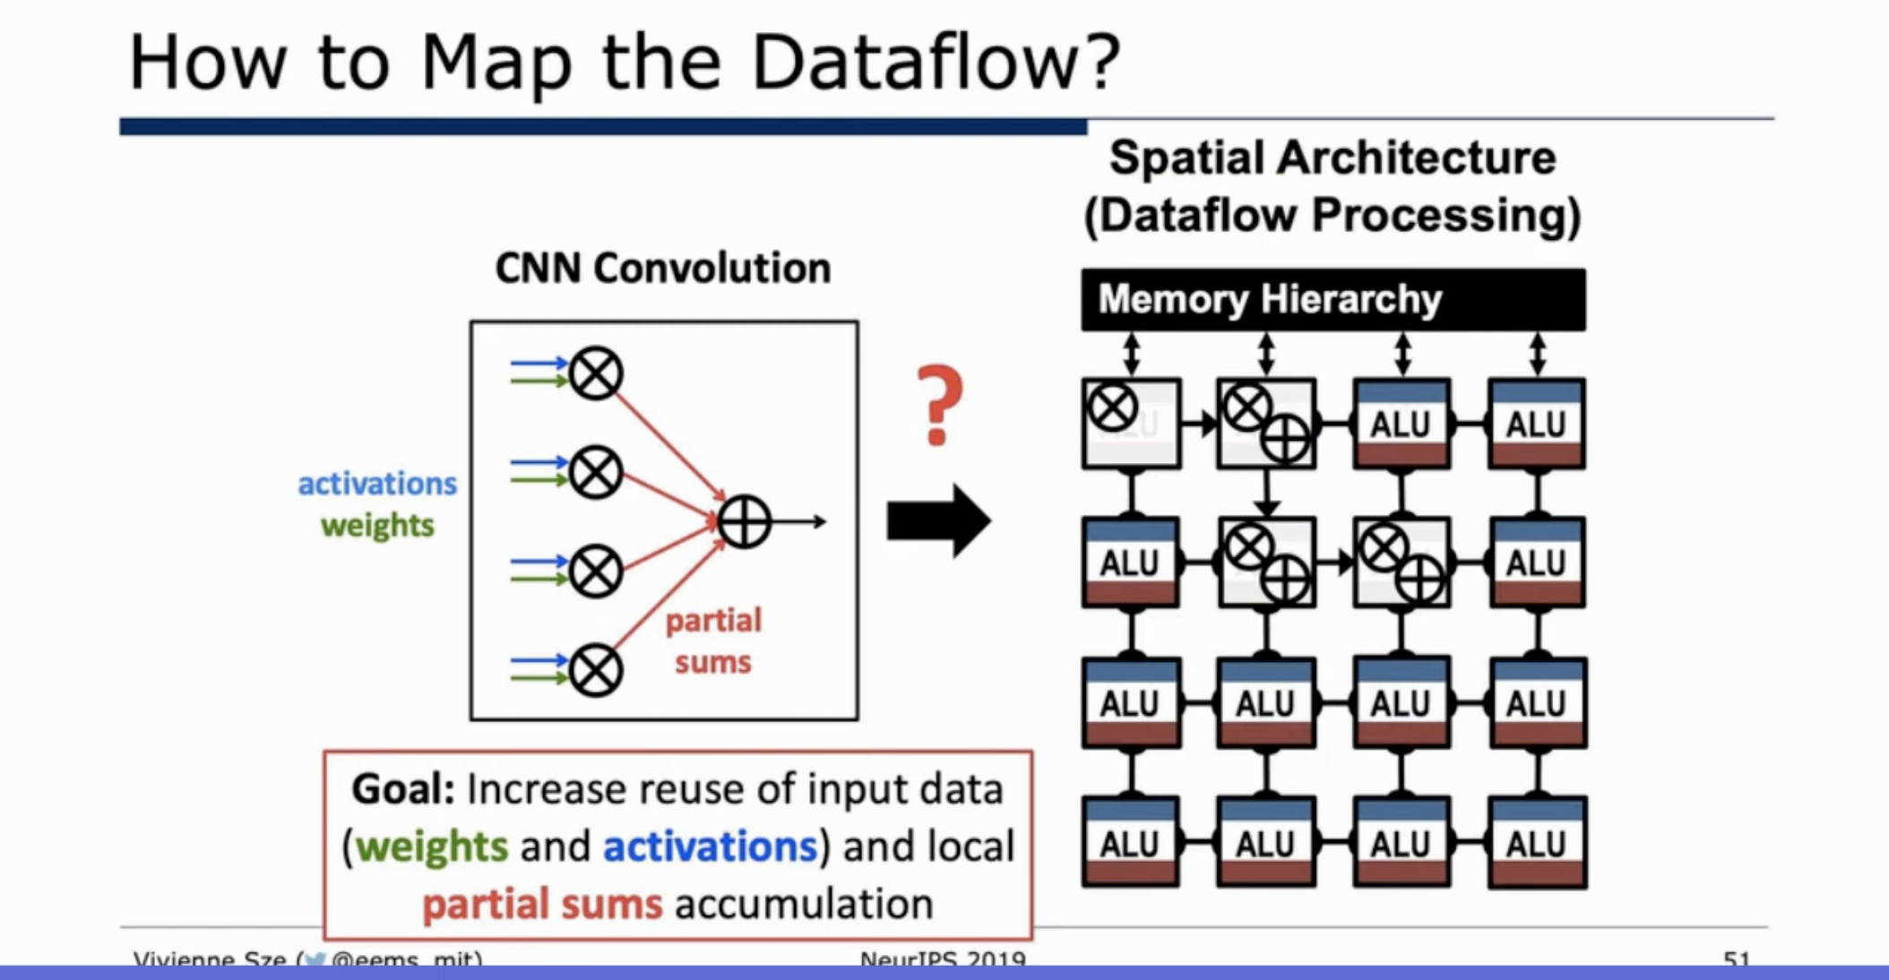

Slide 34
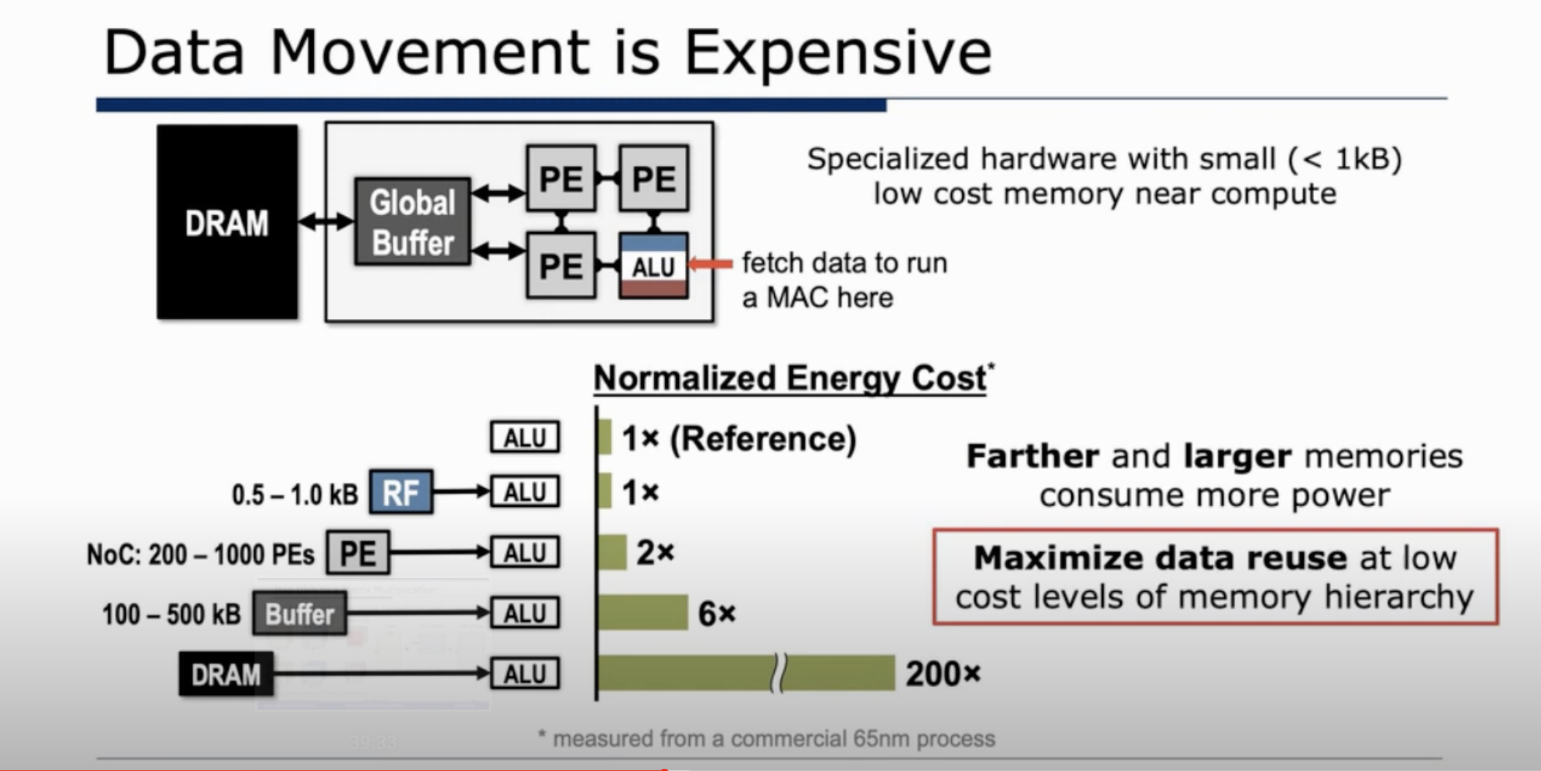

Slide 35
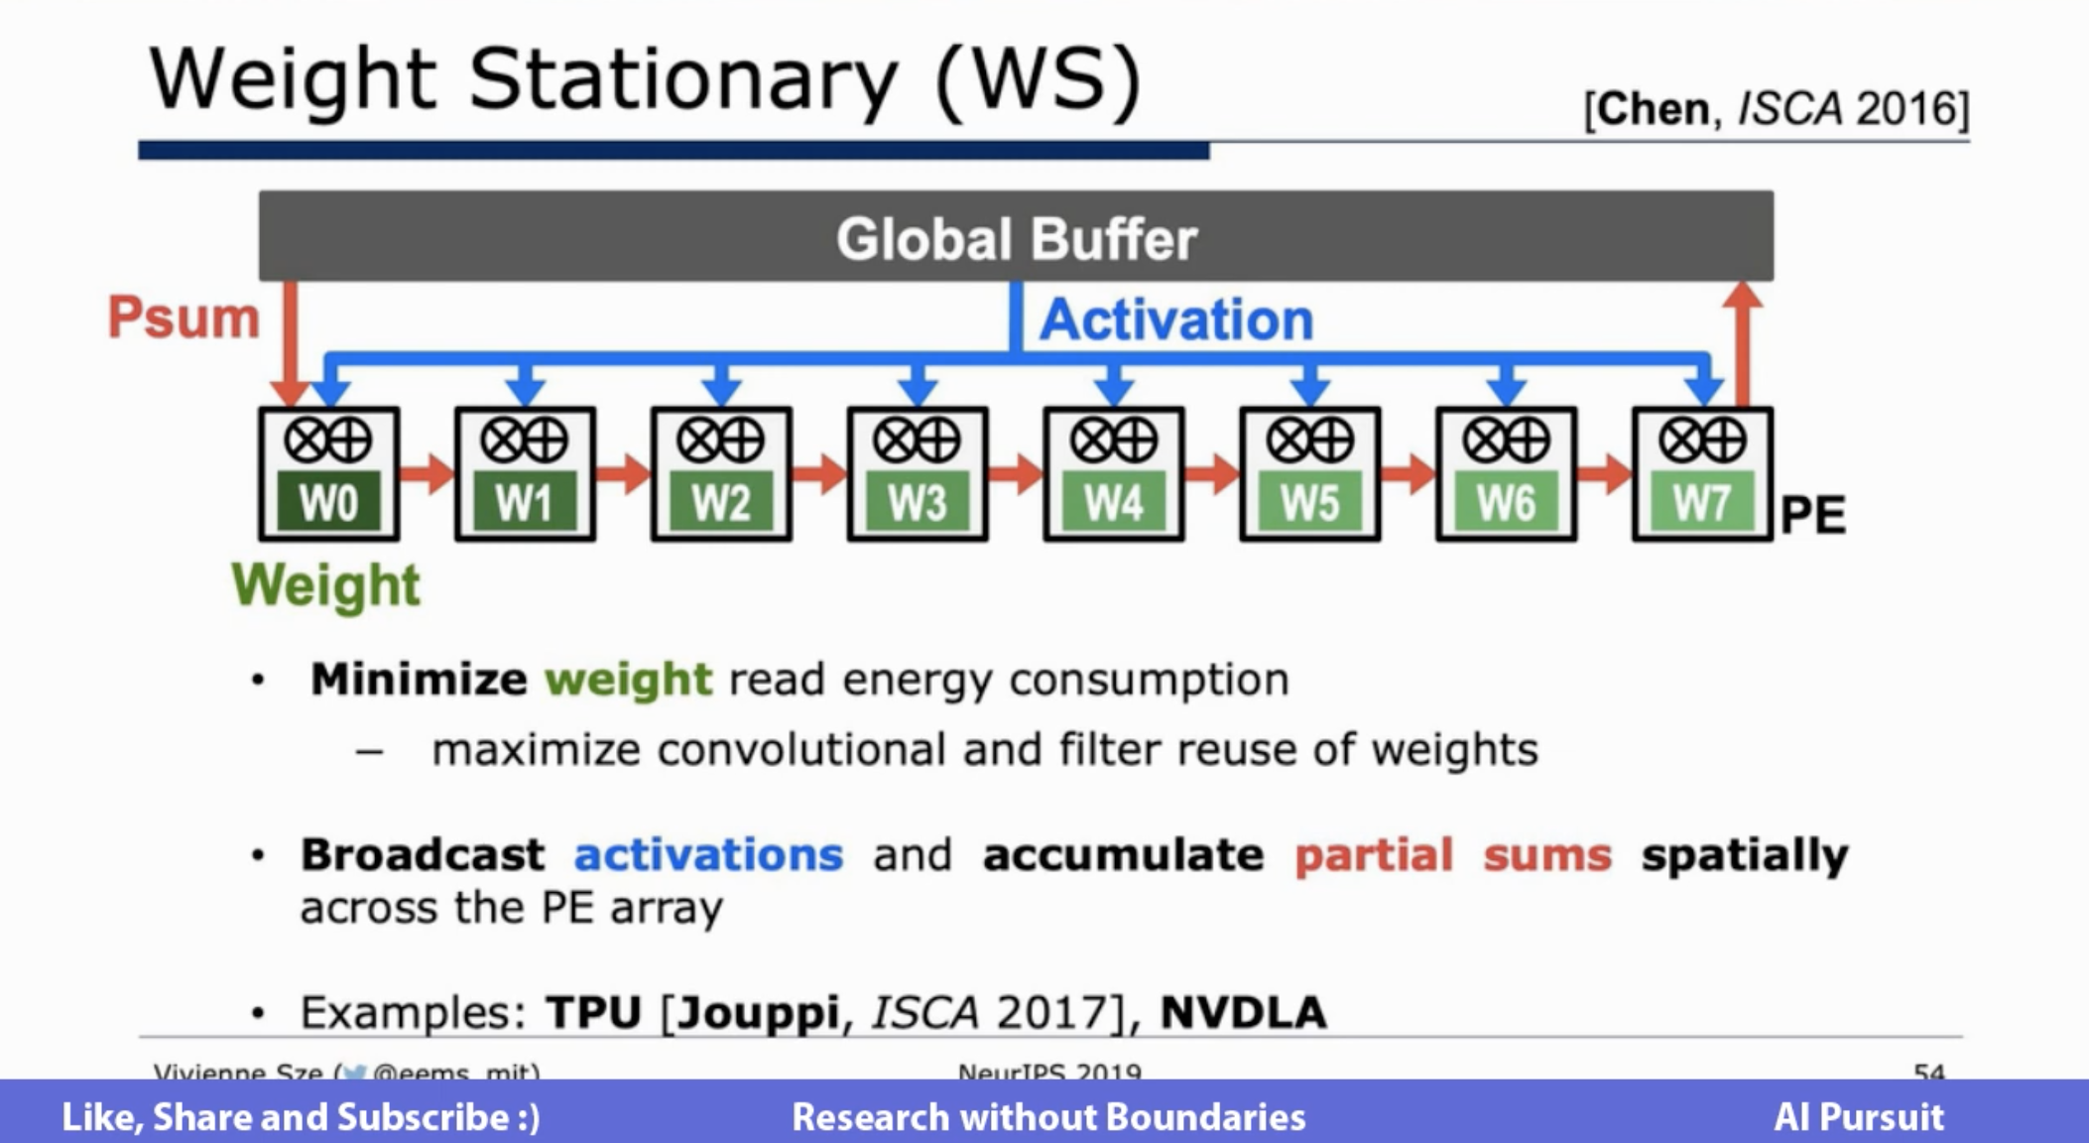

Slide 36
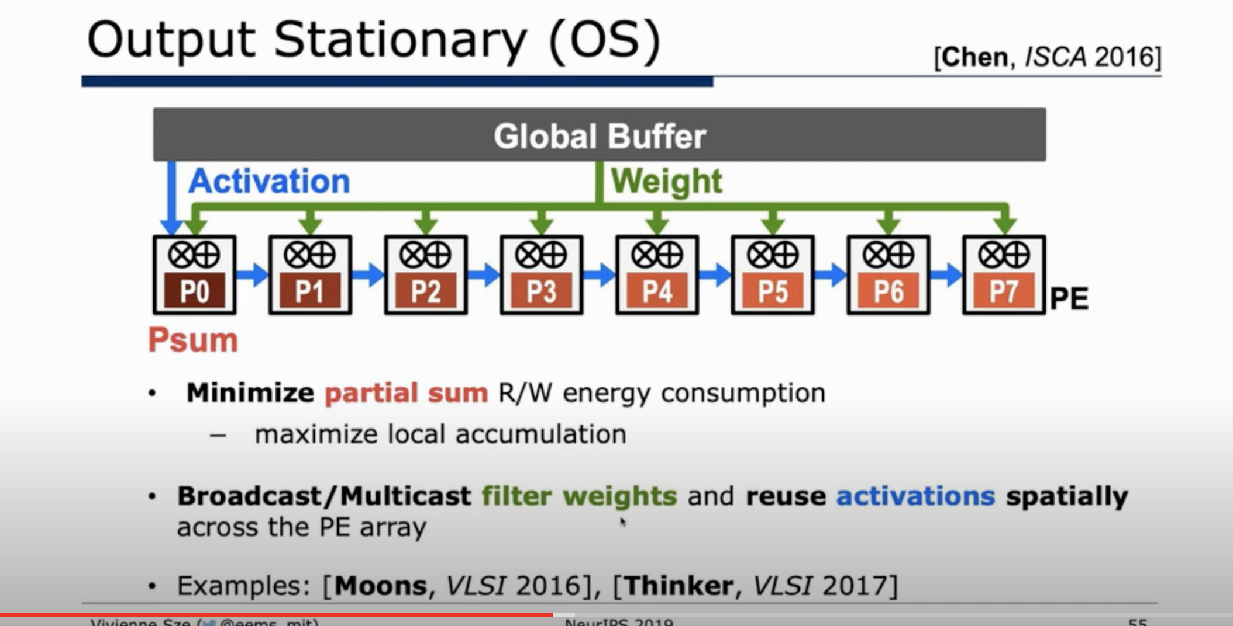

Slide 37
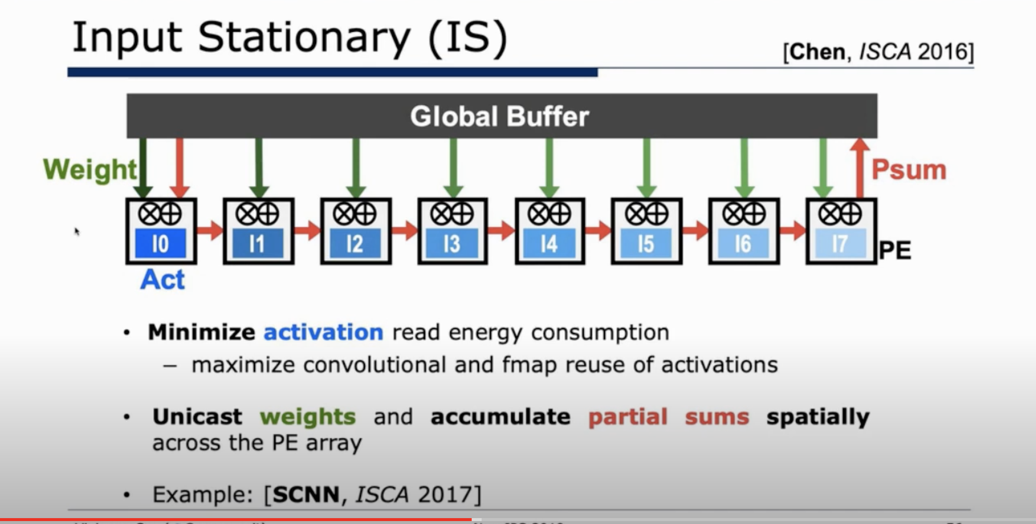

Slide 38
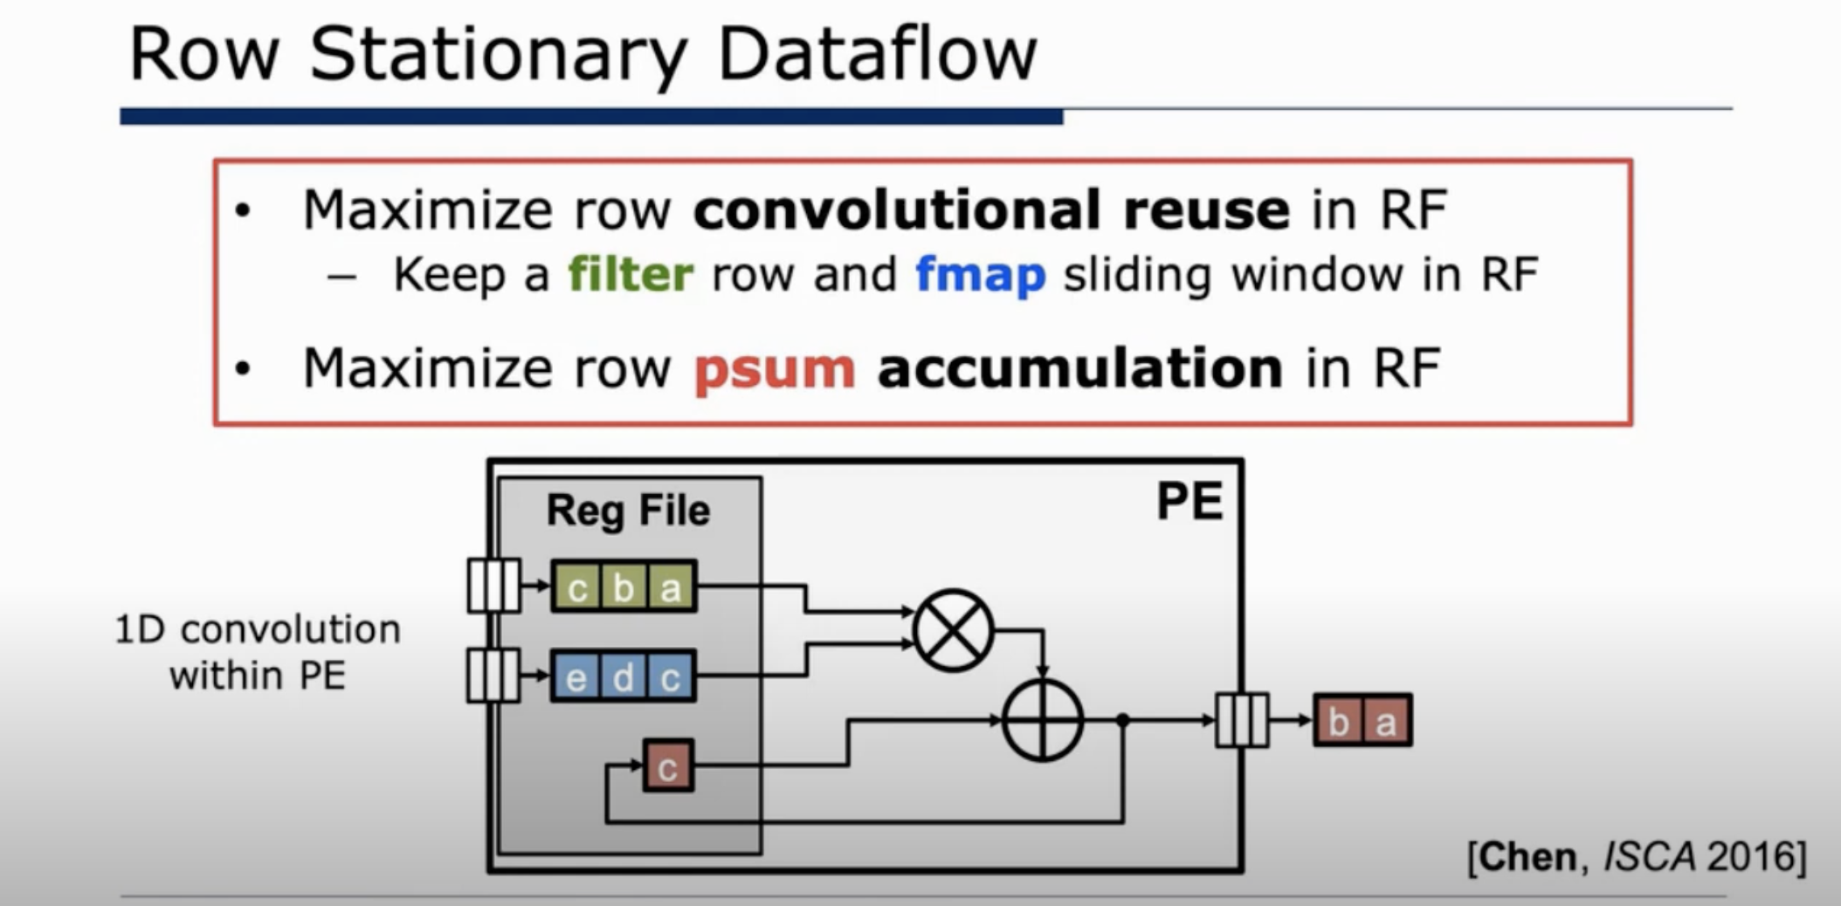

Slide 39
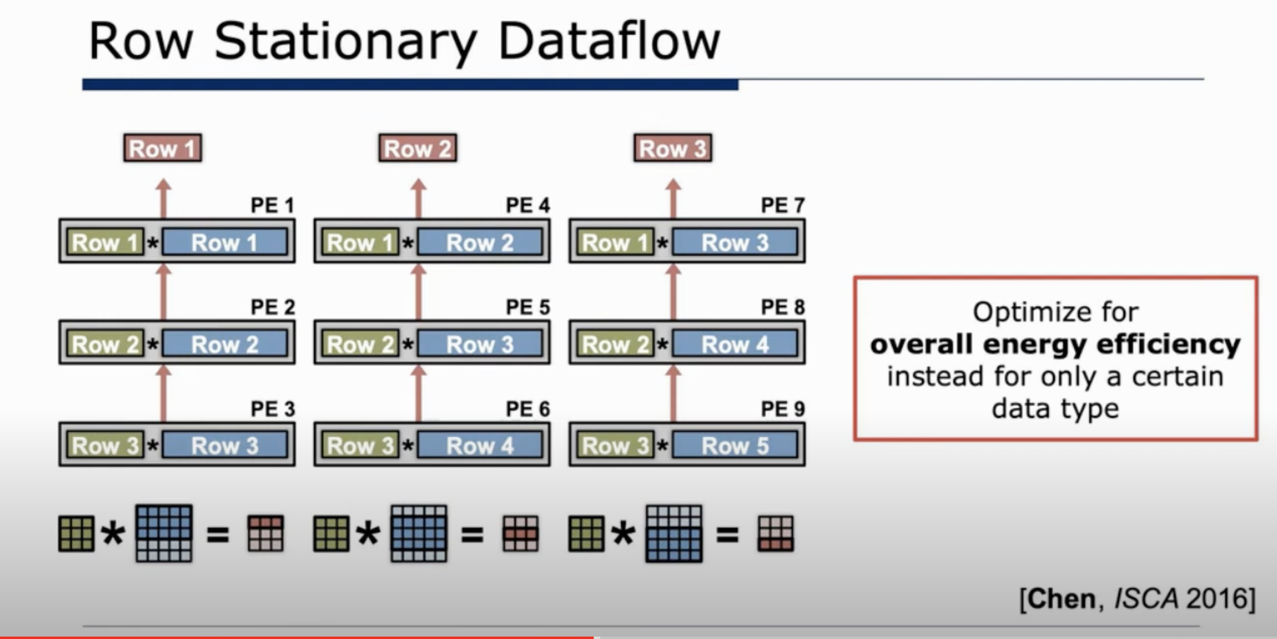

Slide 40
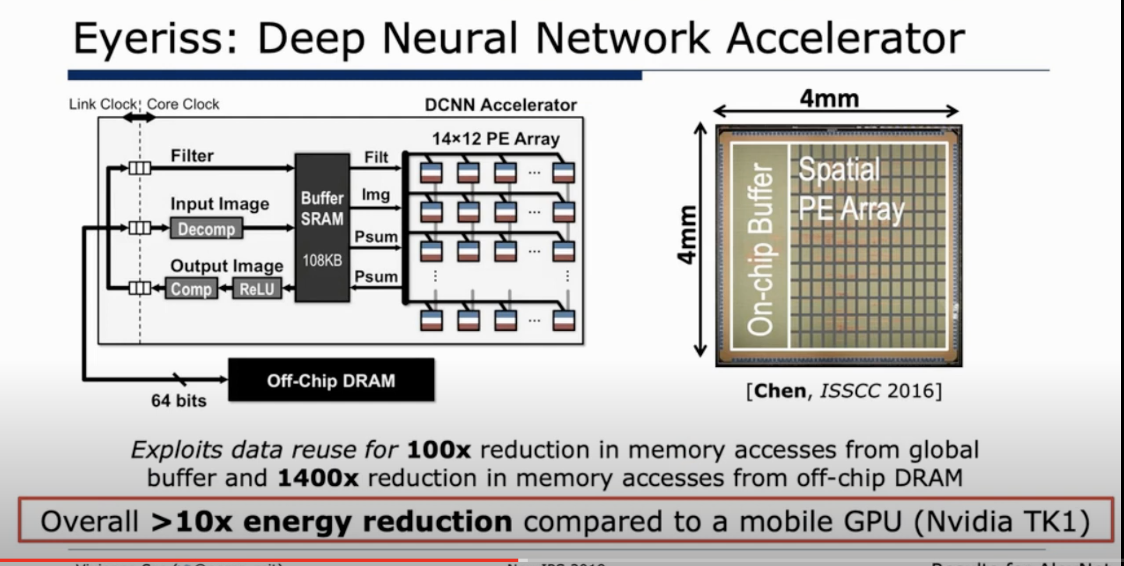

Slide 41
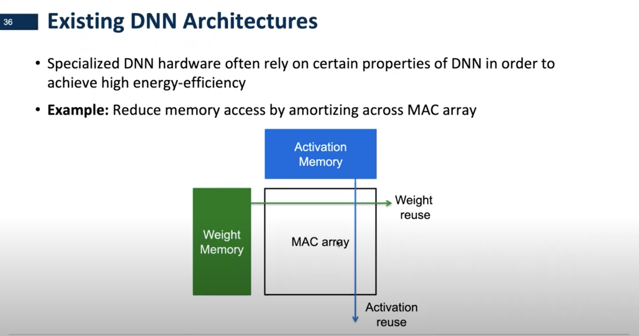

Slide 42
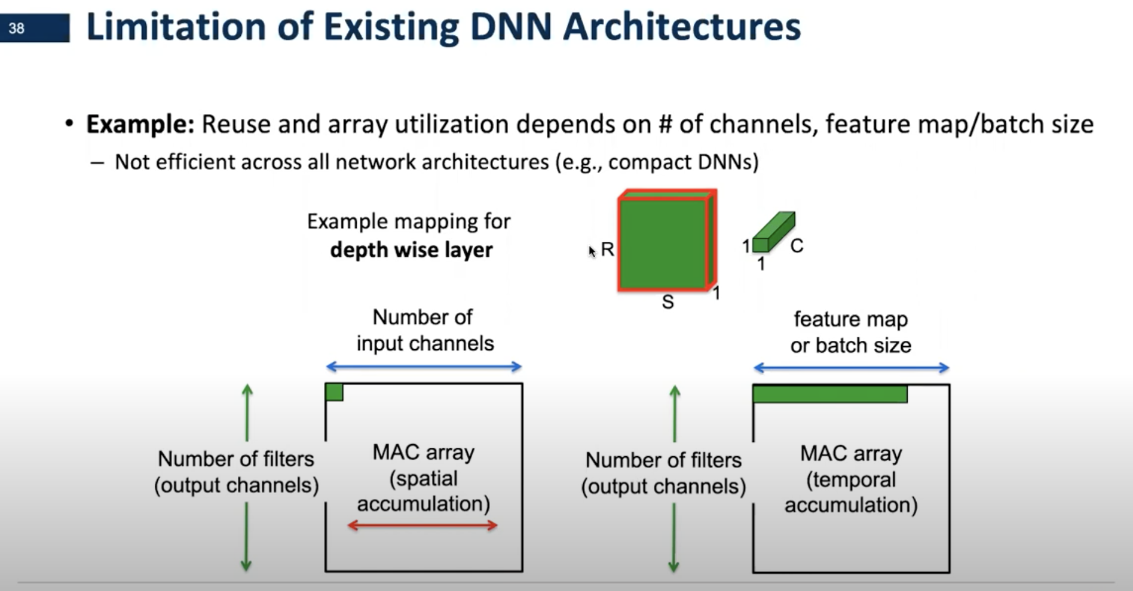
v

Slide 43
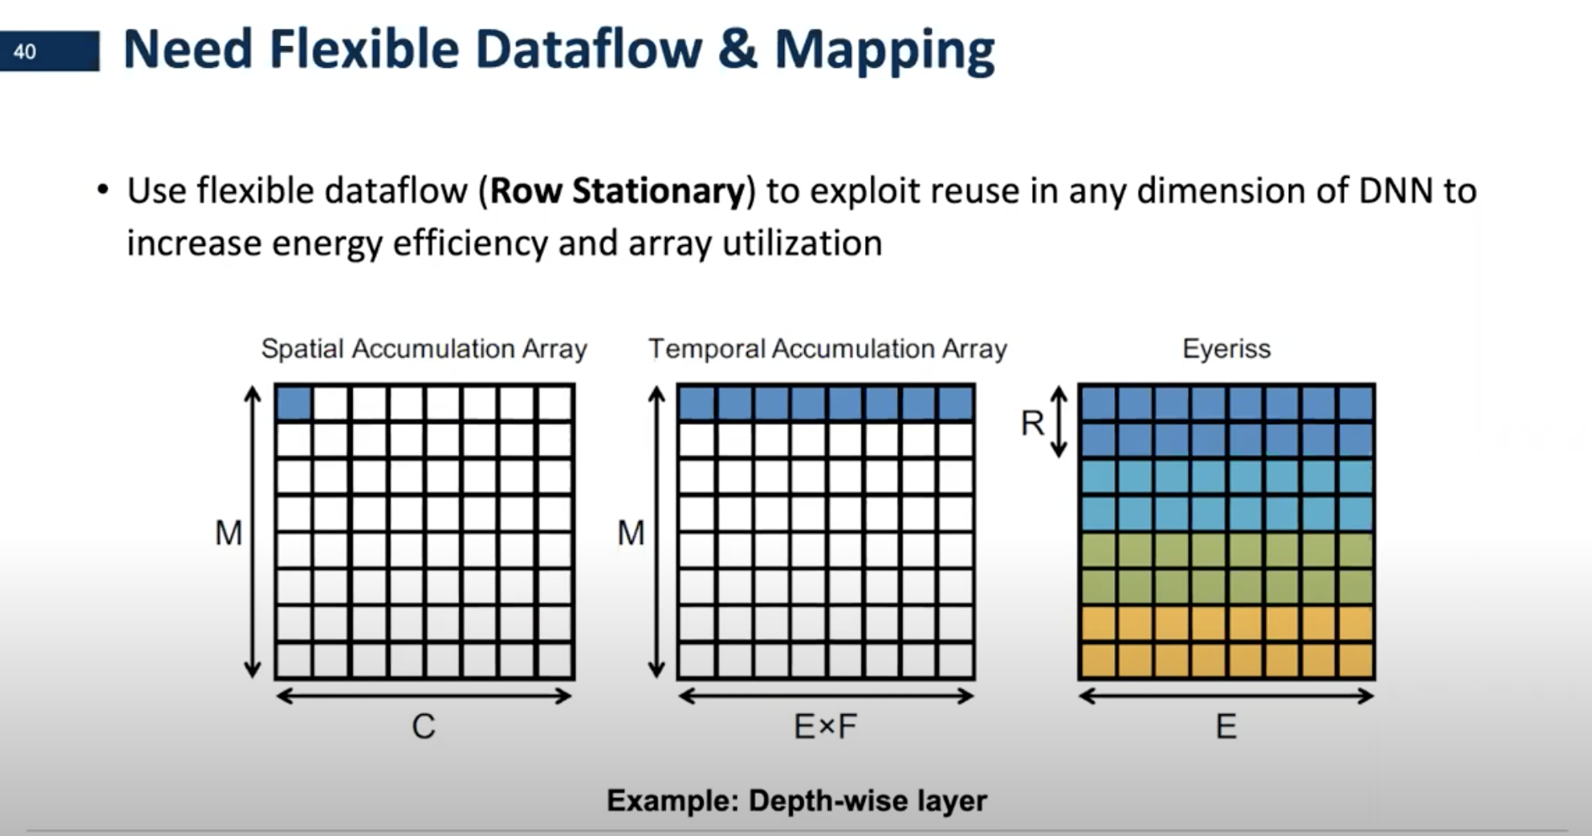

Slide 44
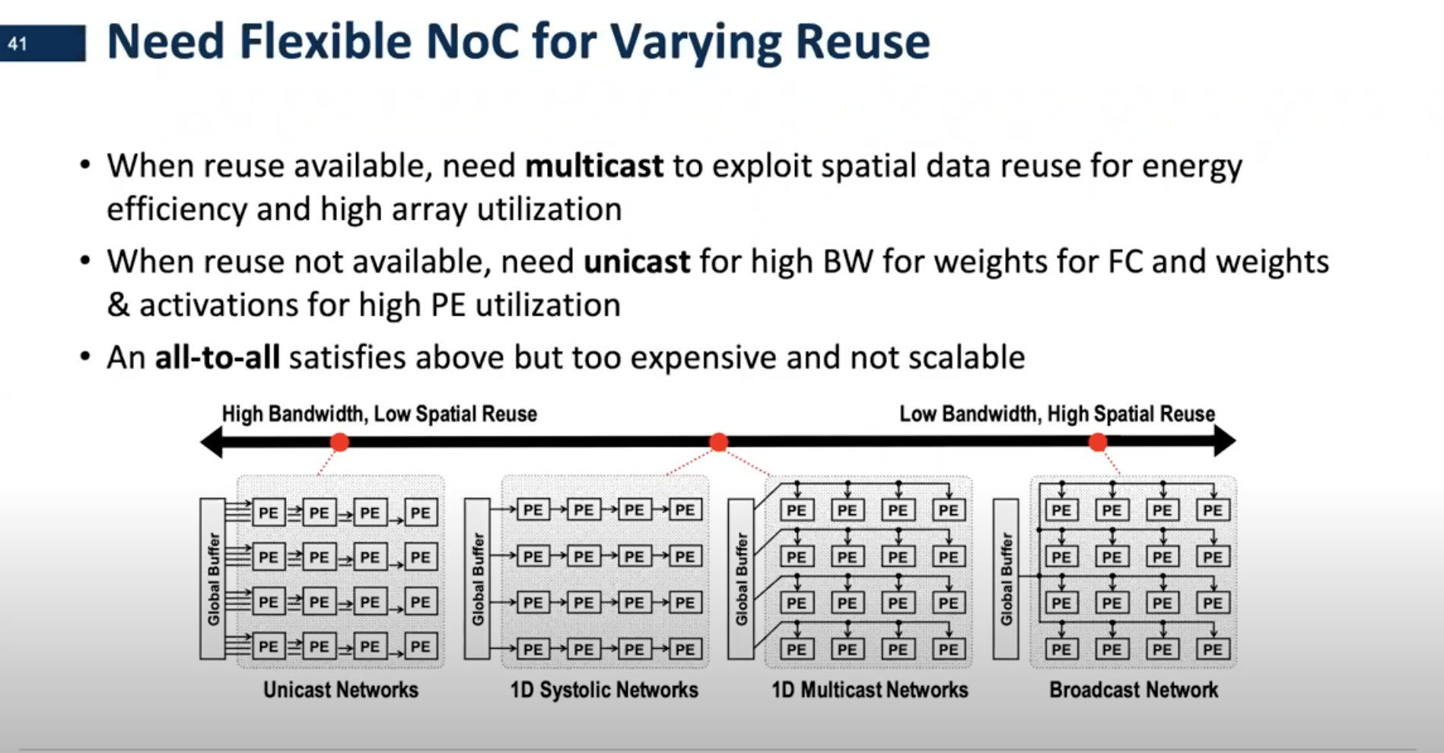

Slide 45
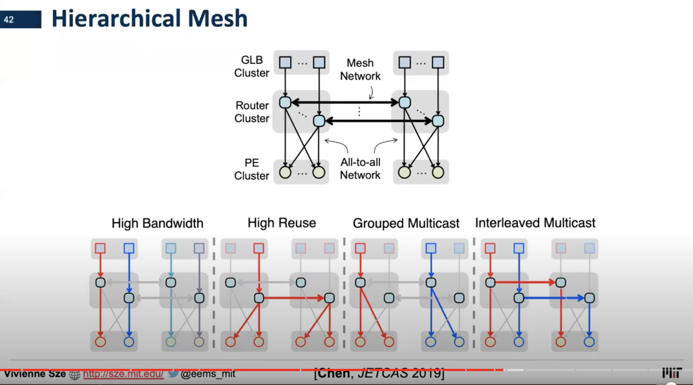

Slide 46
引用

Slide 47
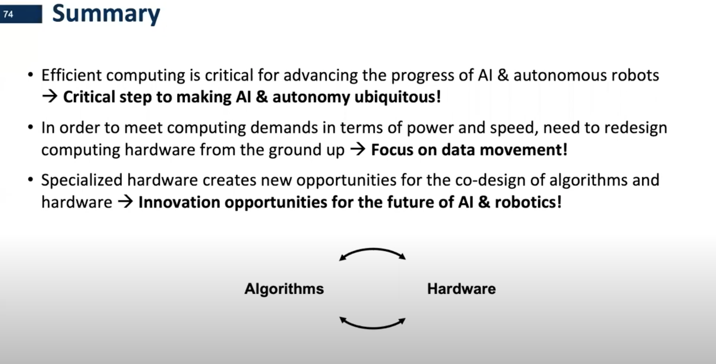

Slide 48
Notes:
48

